Slide 1
Dual-axis Accelerometer

Slide 2
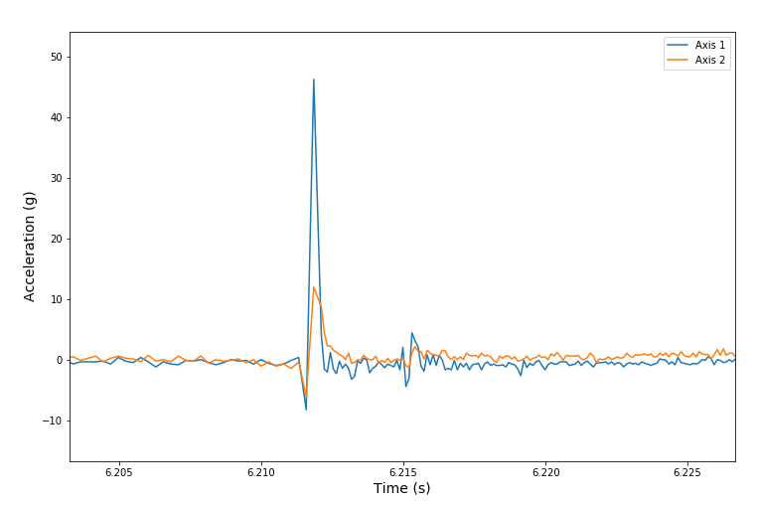
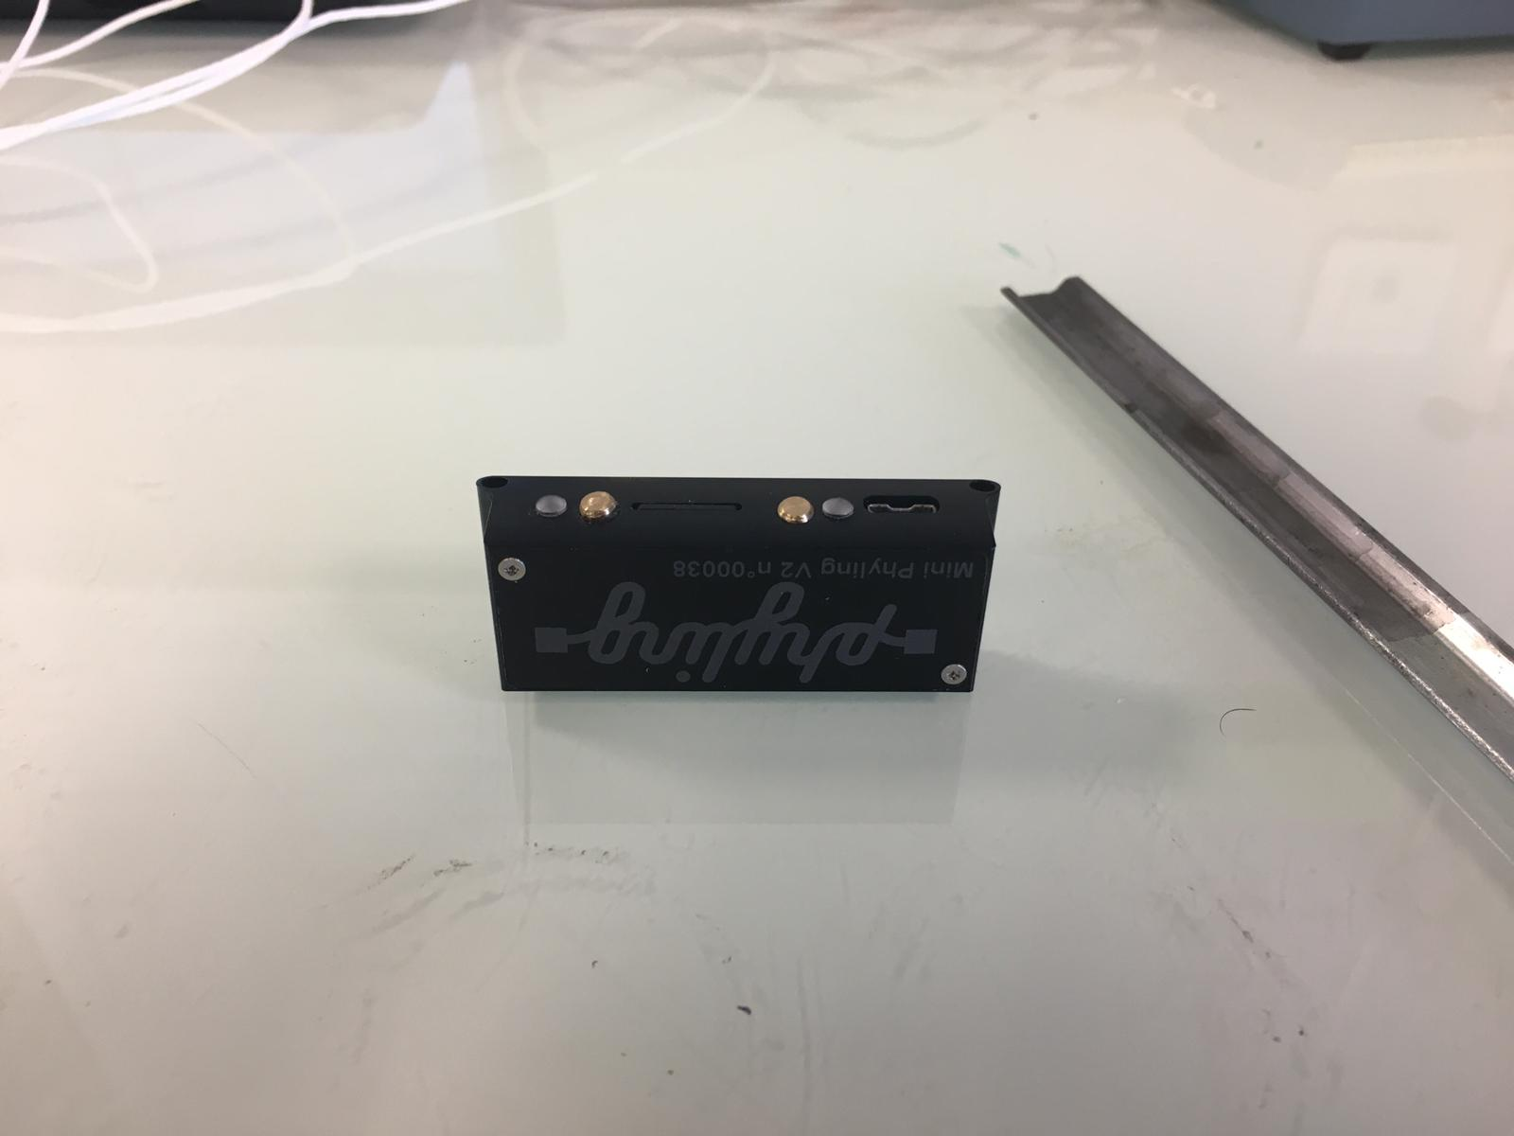
Frontal impact
Impact

Slide 3
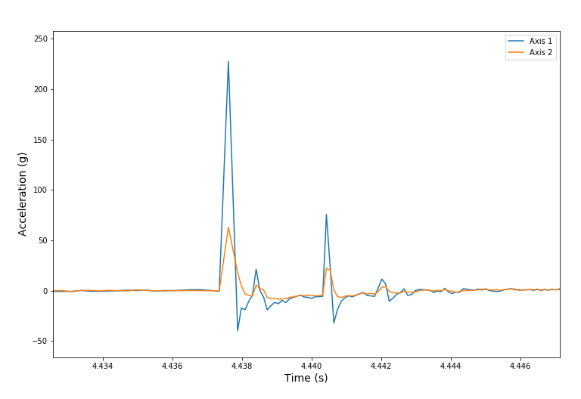
Lateral impact
Impact

